Slide 1



Culture spot
Christmas traditions

Slide 2
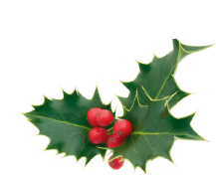
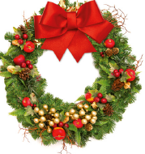
How do people celebrate Christmas?
What are the Croatian customs?
What do you do on Christmas day?

Slide 3
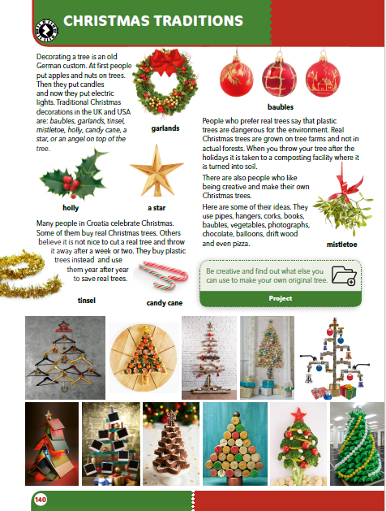
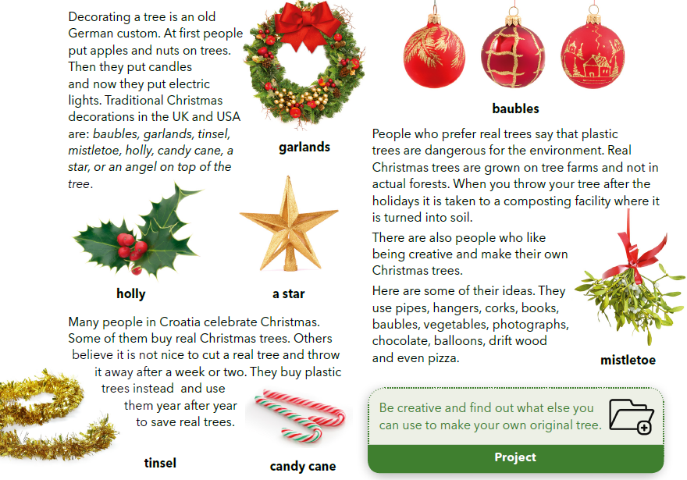
božikovina
imela

Slide 4
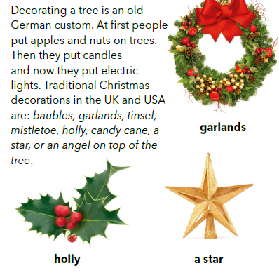
Who decorated the Christmas tree first?
What was on the first Christmas tree?

Slide 5
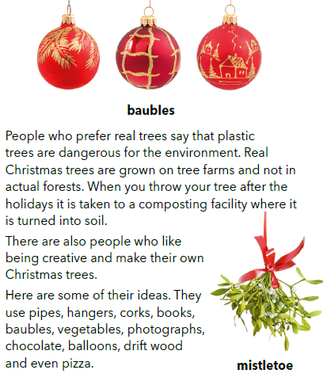
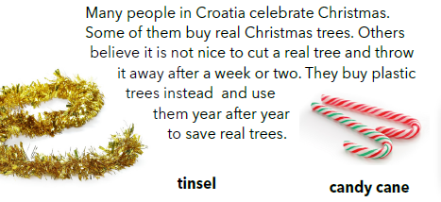
Where do Christmas trees that people buy grow?
What do people who don’t buy trees do? What do they use?
What two kinds of trees do people use each year? Why?

Slide 6
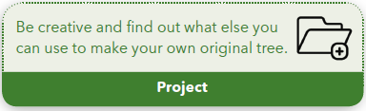
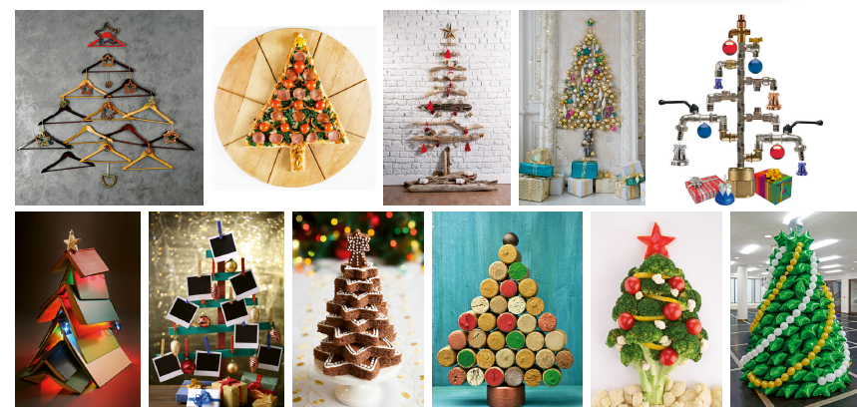
Look at the pictures and describe them.

Slide 7

LEARN MORE
https://www.e-sfera.hr/dodatni-digitalni-sadrzaji/2e69a036-829c-4fd4-a1cf-5998c6a4be45/
New Year's traditions around the world

